Slide 1
Big Data Management & Analytics
MSCI:6110 Fall 2019
Masters in Business Analytics

Slide 2

Welcome to MSCI:6110 !

Slide 3
Course Overview (1)
Time: Tuesday 6:00PM – 9:40PM, 11 weeks
Instructor: Dr. Xun Zhou, Assistant Professor
Elective for Masters in Business Analytics / PMBA
Pre-requisites:
MSCI:9230 Database Systems or 6050 Data Management and Visual Analytics
MSCI:6060 R Programming

Slide 4
Course Overview (2)
Textbook and Readings:
No required textbook. Some readings and online references:
For Database and SQL: Modern Database Management (MSCI:9230 Textbook)
For R: Art of R Programming http://www.nostarch.com/artofr.htm
For Hadoop and Spark:
Apache Hive Guide https://cwiki.apache.org/confluence/display/Hive/Tutorial
Spark and SparkR guide: https://spark.apache.org/docs/latest/index.html
Course materials, announcements will be posted on ICON

Slide 5
Lecture Time Arrangement
Session 1 (6PM – 7:20PM) (break for 20 min)
Session 2 (7:40PM – 9:00PM) (end of lecture)
Individual Q&A (9:00PM – 9:20PM)

Slide 6
Background Requirements
SQL and Database Knowledge (MSCI:9230 / 6050)
R programming (MSCI:6060)
R will be the main language/platform for data analysis
Talk to me if you are not sure about your background
HW0: background survey
Database System
Big Data Management and Analytics
R Programming

Slide 7
Computer and Software (discussed today)
Bring a laptop to classroom.
Software #1: RStudio (you should already have it on your computer if you have taken the R programming)
Software #2: A main-stream web browser.
Software #3 (optional): FTP client to transfer files to the server
FileZilla: https://filezilla-project.org/ (or others if you have a preference).
We will discuss these today.

Slide 8
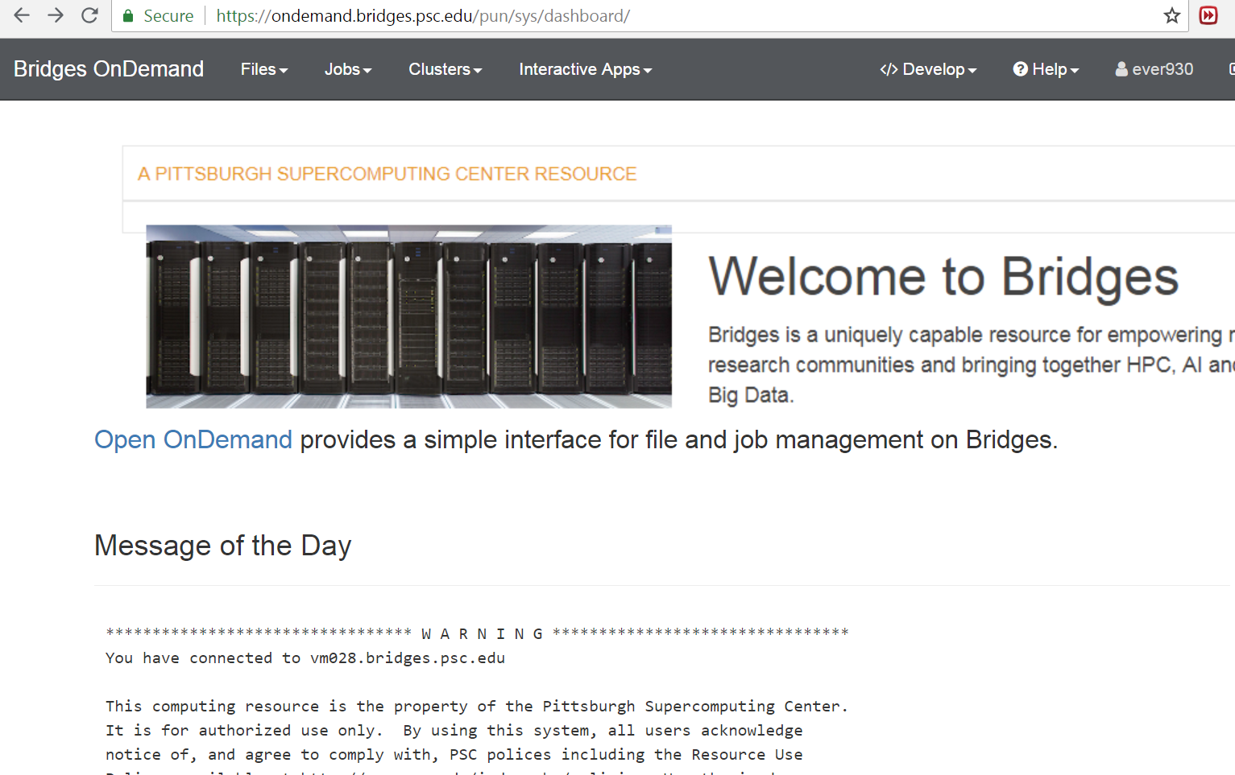
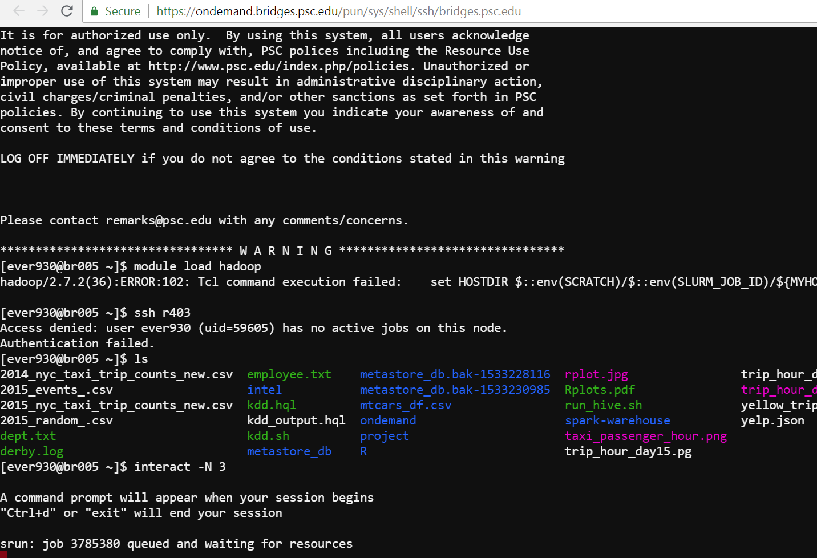
Computer and Software (discussed today)
Bring a laptop to classroom.
New graphical interface is available now. Only web browser needed
https://ondemand.bridges.psc.edu/pun/sys/dashboard/
Shell commands, R studio and file upload/download through web browser

Slide 9

Linux System Commands
We will learn a bit of Linux commands to use the Hadoop server
Windows
Mac OS Linux (and variations)

Slide 10

Hadoop and Spark Server
We plan to use the XSEDE HPC servers
Funded by NSF for education and research
Resources allocated to schools with education needs
You need to register an online account (will discuss today).
Free of charge, budgeted resources, for class only.

Slide 11
Assignments and exams
4 written homework (HW1 – HW4) 40%
1 final big data hackathon 15%
1 Big Data Showcase Presentation 10%
1 course project 35%
Assignments should be submitted online at ICON
Late submissions subject to 25% penalty per 24 hrs (0% after 72 hrs)
See syllabus for details
No written exams
Individual task
Group tasks (3 students)

Slide 12
Course Project (35%)
The course project is done in groups of 3.
Find your team and report your team info in HW0 (Due next week)
Two Phases
Phase 1 (week 2-6): Big Data Management
A mid-term report (10/3)
A mid-term presentation (10/3)
Peer evaluation: give comments to other groups’ presentations and ask questions.
Phase II (week 7-10): Big Data Analytics
A final project report (10/31)
A final presentation (10/31)
Team member peer evaluation at the end of semester – how much everybody contributed to the group? Give a % estimate. Also list specific contributions of each member.

Slide 13
Project (cont’d)
A list of “big” datasets will be given (you can propose your own, too)
Identify your dataset of interest. Understand the data
Create Hive tables and load the data. Generate summary of the data
Bonus for including semi-structured data from the web (API)
Analysis: Use R and SparkR to generate analysis results/plots
Propose your analysis goal
Perform analysis and generate results / conclusion.
See details from the project description on ICON.

Slide 14
Big Data Showcase Presentations (10%)
Each project team has one presentation.
Find an interesting case of big data management or analytics from
Research papers
Articles, accredited online resources
Your own work or experiences (need an abstract)
Make a 15-min presentation to clearly introduce
What is the business scenario? why is this analysis important?
What data is collected? How large? How diverse? What are the challenges?
What techniques are used? Briefly introduce them (no details needed but great if also included).
What are the conclusions and findings? Practical impact?
Your own comments.
A few candidate articles will be provided by the instructor.
Send me your article/case abstract for approval the week before your slot.

Slide 15
Grading Policy
Grading policies: http://tippie.uiowa.edu/mbapm/faculty/grading.cfm
A range ~ 60% (A+, A, A-), B range ~ 40% (B+, B). C, D, F as needed.
Based on ranking of your final score instead of absolute thresholds
You will get lower than B if …
Missing deliverables/exam without a valid reason (e.g., emergency)
Cheating
Performance far below the majority of the class

Slide 16
Contact Information
Email: xun-zhou@uiowa.edu, please include “MSCI:6110 DM” in your subject !
Will generally reply within 24 hours (unless traveling, will announce)
Phone: 319-384-3335 (by appointment)
Meet before/after the class (preferred)
Please plan well, start early. Last-minute questions can’t be addressed (especially technical issues).

Slide 17
Question?

Slide 18
What is this course about?
“Big Data” is the most popular concept in recent years
The success of business analytics requires skills dealing with “Big Data”
What is Big Data?
Data with high Varity: sources, structure, schema …
Data with Large Volume,
Data arriving at high Velocity,
The 3-V’s are the most important challenges of big data!
We will discuss how to address the first two Vs in business analytics.

Slide 19
Business Analytics for Decision Making
Internal Data
External Data
is involved in
Decision
Making
triggers
User
is used in
stores and
maintains
Knowledge
Actions
Internal Data
is the
basis of
is used to
produce
Data
Information
External Data
generates more
Corporate Data Cycle

Slide 20
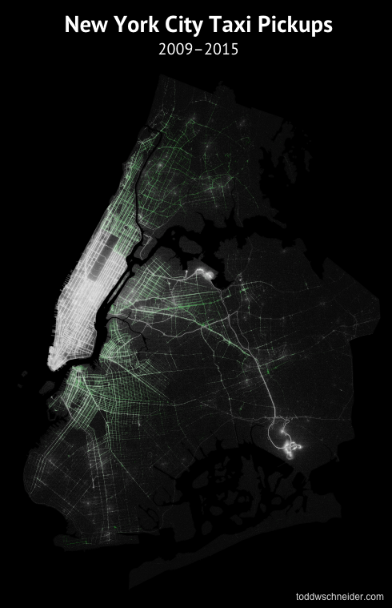
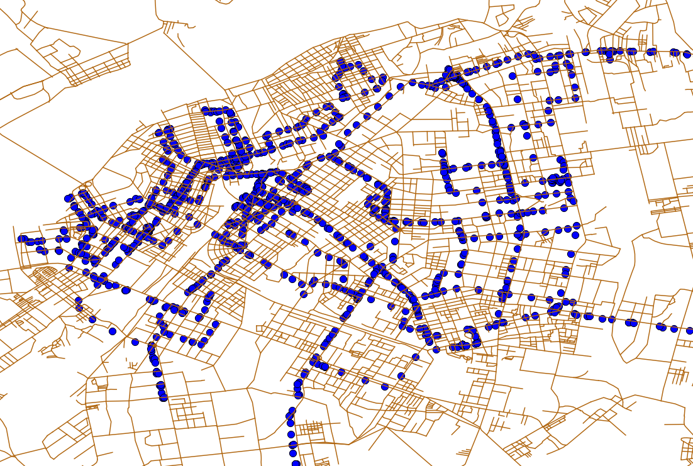
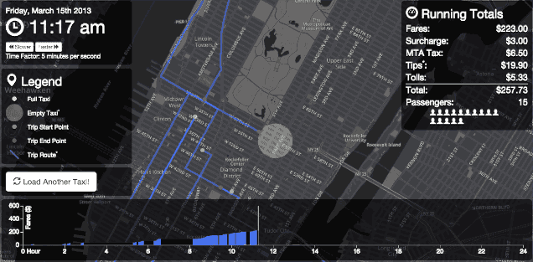
Big Data Example (1)
GPS Records of Vehicles
A sequence of time-stamped points with coordinates
Every taxi is equipped with a GPS device
Over 100,000,000 trips in NYC recorded every year
Where are the popular pickup locations for drivers?
Where to go for more profit?
How to maximize fleet revenue?
Estimate travel time from data

Slide 21
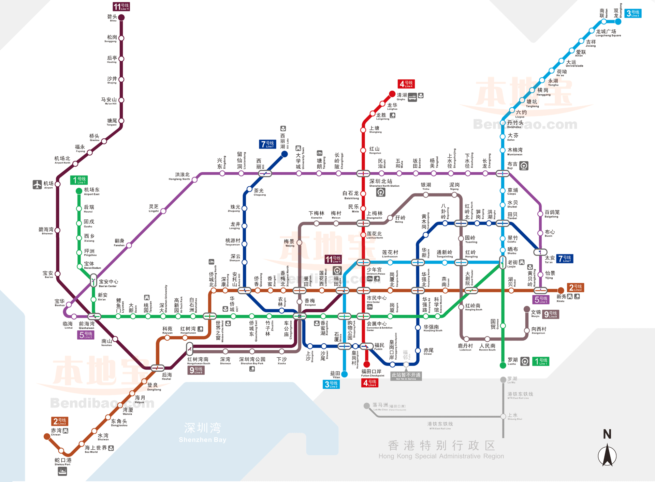

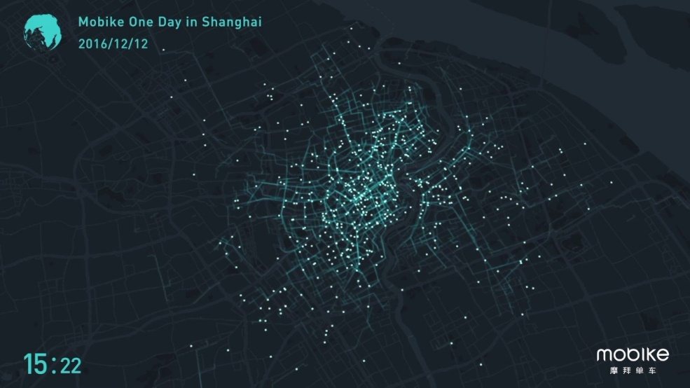


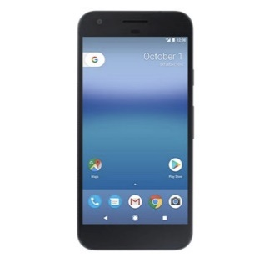
Big Data Example (2)
Other Urban Big Data
Metro card swipe record
Shared bike trajectories
Cellular phone call records
Citations, tickets, and traffic violations

Slide 22
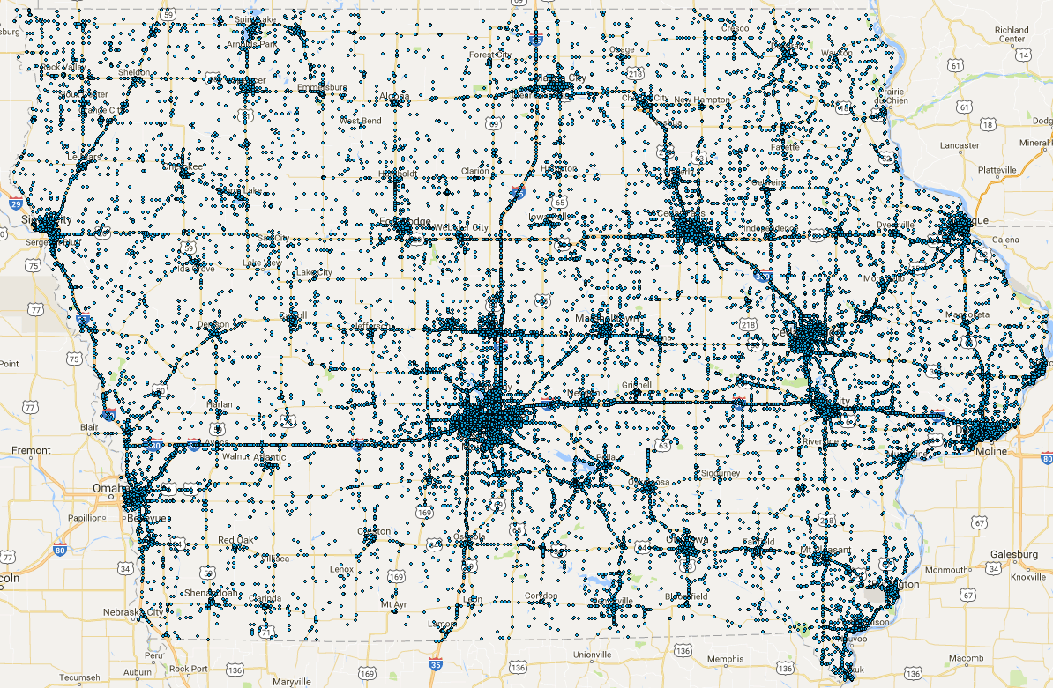
Big Data Example (3)
Motor Vehicle Crash Map in Iowa (2013)
Traffic Accidents Records
Location and Time
Weather, road condition
Car and driver information
Damage, loss
Which roads are more dangerous?
Which car brands are safer?
Injury/death rate vs. car type?
Predict future accidents?

Slide 23





Big Data, Big Value
2018
2011

Slide 24
Big Data Challenges
1. How to manage big data: store, query, and summarize
2. How to analyze big data: learning, analytics, and visualization
Large volume, high variety, high velocity….

Slide 25
Big Data Challenge 1: Large Volume
Successful business analytics also rely on large volume of data
More data leads to more accurate patterns and knowledge
When data volume increases, challenges arise!
What is the average age of users who watched a video on Facebook?
Millions or even billions of users
Count the appearance of each word in a set of web pages
Millions or even billions of web pages
Thousands of words

Slide 26
Big Data Challenge 1: Large Volume
MS Excel or R load/process all the data in main memory
The size of main memory is limited (Typically 4GB-16GB for PCs)
Excel or R can’t handle GB level of data effectively
Databases store data on hard disks
Load from hard disk, process, and write back
Slow in complex queries (e.g., Join) when data volume is large
More powerful computational tool is needed

Slide 27
Examples 1: Average Age of Users
1,000,000,000 users who watched a video or shared an article
What is the average age of these people?
SELECT AVG(Age)
FROM Users
WHERE …
Long time to scan every data record sequentially
User Table
file1
file2
File100
…
…

Slide 28
Example 2: Word Count
Count the appearances of words in a set of documents
1,000,000 web pages, where each page has 1000 words
3000 keywords
Actual numbers in reality (e.g., Google) might be much larger.
Database Solution:
Table A: Pages, Table B; Keywords.
JOIN A and B on “B shows up in A” (Billions of rows in the result table)
For each B, sum the number of appearances in each row of A (GROUP BY)
Very time consuming (hours, if not days depending on your data volume)

Slide 29
New Computation Paradigms
Computer Hardware is getting cheaper and cheaper
Connect computers together and share several replica of the data
Distribute the computational tasks to each computer
Multiple computers can work simultaneously
Results can be combined after the computers finish the assigned tasks
MapReduce is a new distributed data processing model
Hadoop is a distributed database using the MapReduce model

Slide 30

Hadoop and MapReduce
Like relational DB, Hadoop has its own query language
HiveQL is a query language developed for Hadoop
Create “tables”, issue queries in Hadoop using HiveQL
HiveQL will transform your query to distributed MapReduce tasks

Slide 31

Variations of Hadoop: Spark
While Hadoop is very powerful in processing large data queries, it is not designed for complex data analysis
How to do a linear regression on 10GB (billions of rows) data?
A variation of Hadoop is developed: Spark
Spark allows different computers to share data in their main memory
An R package (SparkR) is developed.
R commands can run on Spark

Slide 32

Data Analysis Tool: R
R is an open source data analysis tool
Based on a highly modular package system
“R is a free software environment for statistical computing and graphics.”
We will use R as our primary data analysis platform
Combining R with DBMS and Hadoop will enhance our data analysis ability
R can be used in a interactive, command-line mode.

Slide 33

Analysis using web service data
Map of Tweets and Flickr photos
Source: http://www.fastcodesign.com/1664462/infographic-of-the-day-using-twitter-and-flickr-geotags-to-map-the-world

Slide 34
Big Data Challenge 2: Variety
How to obtain the data you want?
How to interact with the web services from these data providers?
How to process these data and transform them into a unified format?
How to load the data into a data warehouse or database?
Most of the data are not provided in structured format (2-d tables)
XML documents
JSON documents
How to process data in such formats?

Slide 35
Big Data Challenge 2: Variety
Relational Data is “Structured Data”
Tables, rows and columns are clearly defined
All the records must have the same number of fields
Values indexed by row number and column number
However, relational model is too strict and is less flexible on new apps
Twitter and re-tweets
GPS trace of a taxi
Most data shared on the web are not structured!

Slide 36







Data in Business Analytics
Rich data available on the web for analysts and developers
Google, Yelp, Facebook, Twitter, Zillow… They all share some data
Successful business analytics should integrate data from multiple sources
The price of a house may depend on:
The feature of the houses, size, year, style (Zillow, Trulia)
Local Safety and Education (opendata.gov)
Life quality (Yelp)
Transportation and traffic (Google Map)
?

Slide 37
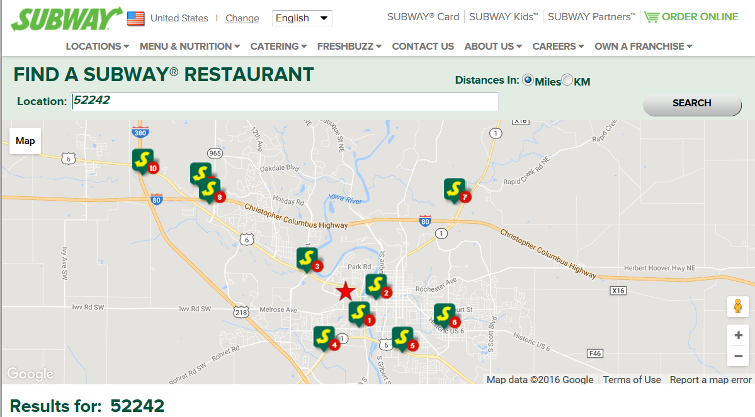
Web Services
Subway: Store locations and ICONs
Google: Map and Routes

Slide 38
Road Map of the Course
Semi-structured Data
Structured Big Data
Part 3: semi-structured data
XML, jsonlite, rjson
Data Analytics using R
Spark
Hive and HiveQL
SparkR
Part 2: Performing analysis on big data
Part 1: Big data management
Analysis Results
Charts, Reports, etc

Slide 39
Next Session
Setting up XSEDE Accounts, Install Software
Review SQL

